Slide 1
Synthesis writing
WRITING A SYNTHESIS ESSAY

Slide 2
What is synthesis?
◆ A synthesis is a written discussion incorporating support from several sources of differing views. This type of writing requires that you examine a variety of sources and identify their relationship to your thesis.
◆ It is a meaningful and insightful connection between different materials by the identification of common themes or traits.

Slide 3
It’s the creation of knowledge not the summarization!
◆ a synthesis essay is to create new knowledge out of existing knowledge and sources.
◆ To combine sources and the writer’s position to form a cohesive supported argument, accurately citing the sources.

Slide 4
Types of Synthesis Essays
Explanatory
Argumentative
Review

Slide 5
Types of Synthesis Essay
◆ Explanatory synthesis helps readers make sense of a complicated topic. You don’t have to argue a point, just present facts, data, and different perspectives. This type of synthetic writing is common for research papers and scientific articles. Literature review or background sections use explanatory synthesis.
◆ Argumentative synthesis supports a controversial position based on the data presented across a variety of sources. It’s an argumentative paper with a twist. Aside from listing critical points, you need to consider the relationship between references, especially if the authors support opposing views.

Slide 6
◆ A review synthesis paper is a summary of research whose goal is to discover previous findings on the topic. Instead of proving your point based on the sources, you simply examine the ideas presented in those topics. As a rule, a synthesis essay thesis in such a case may simply state that the issue has not been properly discussed yet and requires more research.

Slide 7
Where is synthesis used?
Analysis papers to examine related theories.
Argument papers to compare differing views and support a coherent claim.
Business reports to examine differing ideas and blend into a coherent plan.
Research papers to incorporate multiple sources.

Slide 8
Before Writing Your Synthesis, do the following:
Narrow your topic
Summarize briefly common themes or traits in texts
Organize your research

Slide 9
Strong synthesis essay provides:
A strong and supportable thesis
A depth of discussion and effectiveness of argument
A strong conclusion

Slide 10
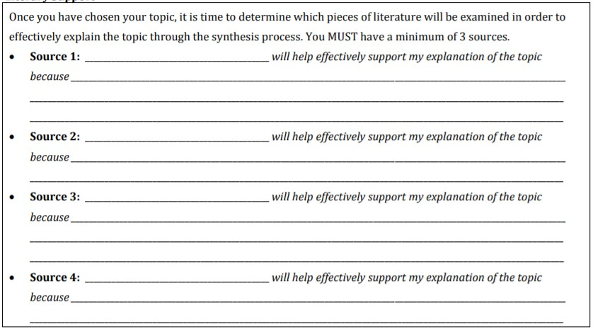
Outline your findings

Slide 11
Points to ponder!
◆ As you read sources, jot down a few lines summarizing your takeaways
◆ What conclusions can you draw?
◆ Which side of argument does this source add to?
◆ Some sources will be pictures/graphs: what can you take from them?

Slide 12
Step One: Before Writing
◆ Collect your sources on the topic
◆ Familiarize yourself with what others have written about the topic
◆ Write a brief summary of each of your sources
◆ Examine the evidence that other writers have used to support or to argue against the issue
◆ Formulate your own thesis, after reflecting on your research

Slide 13
Step Two: Pre-Write
◆ Read all the documents and note the following:
The title, author, and publishing information (for citing)
The position of the source on the topic (neutral, positive, or negative)
The summary of the source’s main idea
Two or more direct quotes to use as supporting evidence (with page numbers)

Slide 14
Step Two: Pre-Write
◆ Using your thesis as a starting point, free-write, brainstorm, question or map out ideas on the topic
◆ Using the pre-writing material you generate, create a scratch outline
◆ Note: It is ALWAYS wise to create a short scratch outline for your essays. However, for synthesis essays, this step is essential if you are to clearly and logically organize your multiple sources

Slide 15
Sample scratch outline for a synthesis essay
◆ Thesis: The two memoirs, All Over but the Shoutin’ by Rick Bragg and The Color of Water by James McBride, share the theme that, with familial support and love, we can overcome obstacles
◆ Supporting Point 1: In All Over but the Shoutin’, Rick Bragg’s mother teaches him to persevere in difficult circumstances
◆ Supporting Point 2 (with transition): Like Bragg, in The Color of Water, James McBride’s strong mother instills in him the importance of education as a path out of poverty

Slide 16
Do I Need a Thesis Statement?
◆ Thesis statement is the core of your essay.
◆ Fully address the complexity of the problem. This means that your thesis should encompass all the crucial points of the topic.
◆ Express your firm position. This applies to argumentative essays, not the explanatory ones. Do not try to play it safe. The professor will not grade your opinion, only your writing.
◆ Provide organizational patterns for the essay. You can’t squeeze the whole paper into a single sentence, but you can list the main points and possible counterarguments, turning the thesis into a mini-outline.

Slide 17
Step Three: Write
◆ For each of your supporting points, write a complete sentence; use these as the topic sentences for all of your body paragraphs
◆ Using the topic sentences and your scratch outline, write the essay
◆ Using the summaries you wrote for each of your sources (see Step One), add these quotations, facts and opinions to prove each of your key points
◆ HINT: DO NOT include lengthy summaries of your sources in your essay but very brief summaries that support your thesis directly and clearly

Slide 18
Step Four: Revise
◆ Be sure that your thesis covers all the supporting points
◆ Be sure that you have introduced all of your sources in the introductory paragraph
◆ Check that each body paragraph begins with a clear topic sentence to focus the main idea
◆ Make sure that all of your evidence supports your thesis clearly; edit out any facts, quotes or ideas that do not (or move them to paragraphs where they logically belong)
◆ Add quotations, facts or opinions of your sources where you are lacking adequate evidence
◆ Be sure that you have introduced the writer of all quotations by putting the name of the writer in your text, right before the quote
◆ (According to Smith,”XXXXX”)

Slide 19
Step Five: Edit
◆ Add, delete or move ideas as needed
◆ Proofread for grammar, mechanics, punctuation, word choice or typographical errors

Slide 20
Sample outline for a synthesis essay
A synthesis essay should be organized so that others can understand the sources and evaluate your
comprehension of them and their presentation of specific data, themes, etc.
◆ The introduction (first paragraph)
Thesis sentence that sums up the focus of your synthesis.
Also introduces the texts to be synthesized:
Gives the title of each source (following the citation guidelines of whatever style
sheet you are using);
Provides the name of each author;
(ii) Sometimes also provides pertinent background information about the authors, about the texts to be summarized, or about the general topic from which the texts are drawn.
◆ The body of a synthesis essay:
Each paragraph should:
◆ 1. Start with a topic sentence;
Include information from more than one source;
Indicate the names of your sources;
.
◆ Conclusion.
Write a concluding paragraph that restates your thesis in different words and summarizes themes
you have found and the ways they connect to the overall topic.

